Slide 1
Natural Language Processing on 120k Claims By: Sai Charan (NLP Data Scientist)
.

Slide 2
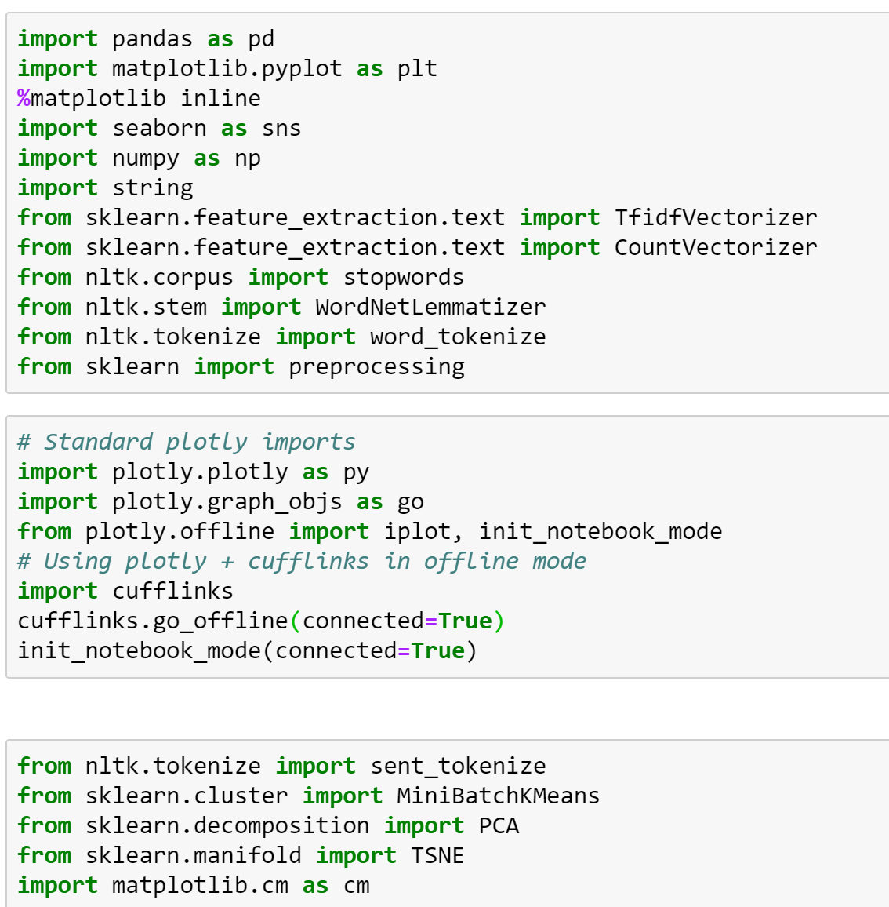
Importing essential Libraries

Slide 3
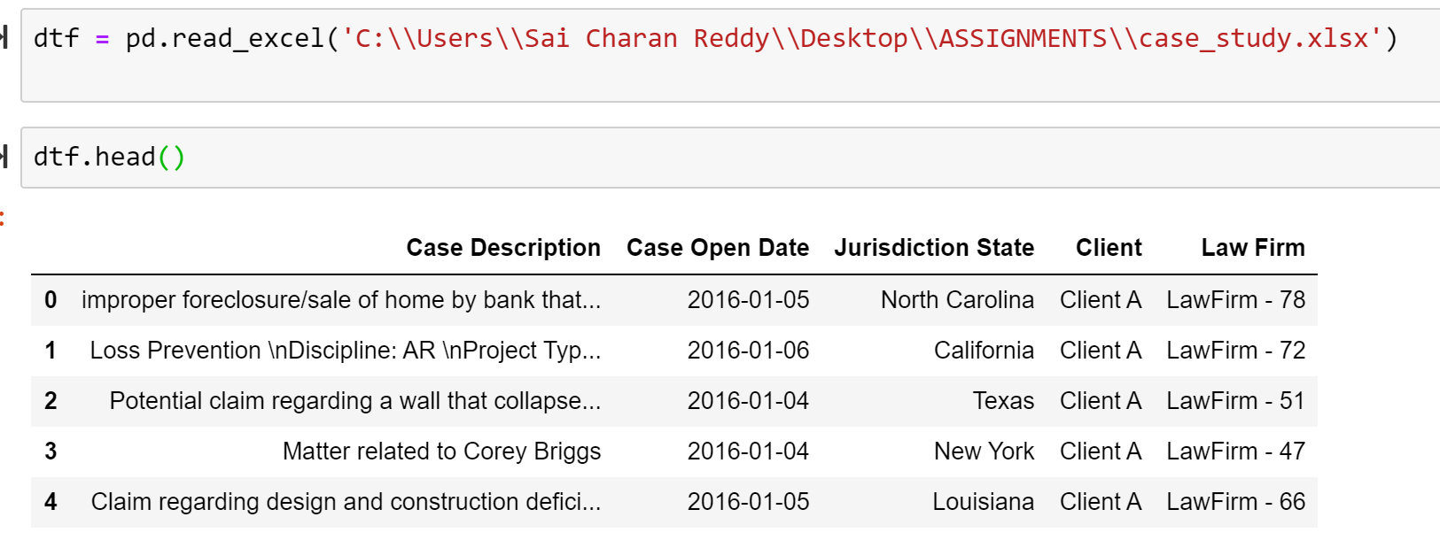
Data importing

Slide 4
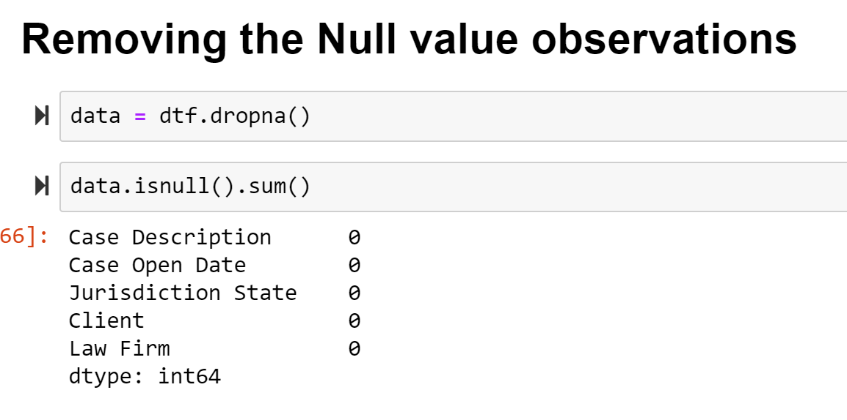

Slide 5
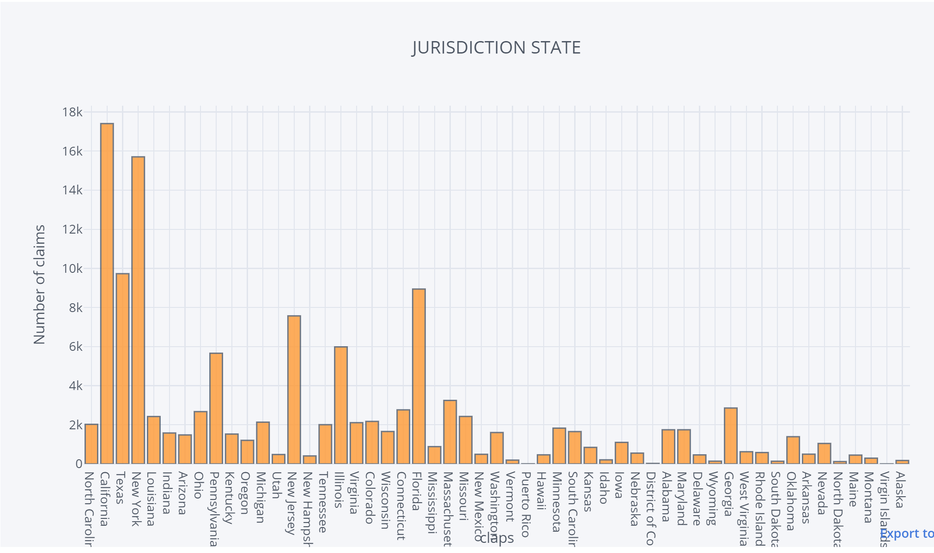
EDA on Jurisdiction State

Slide 6
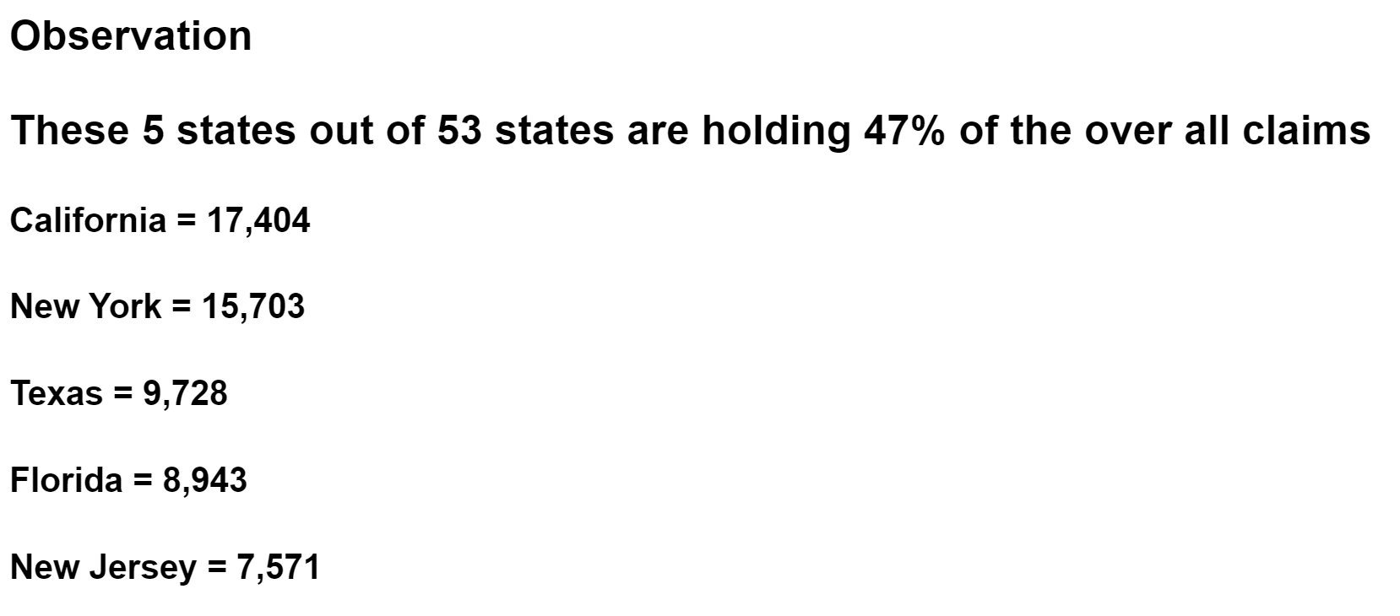
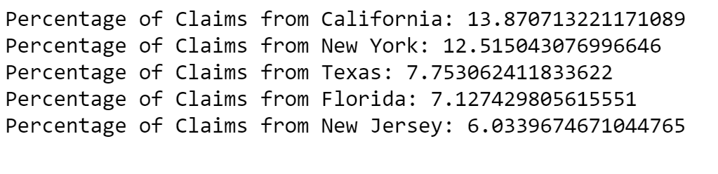
Observation and Percentages of Claims for the top 5 States

Slide 7


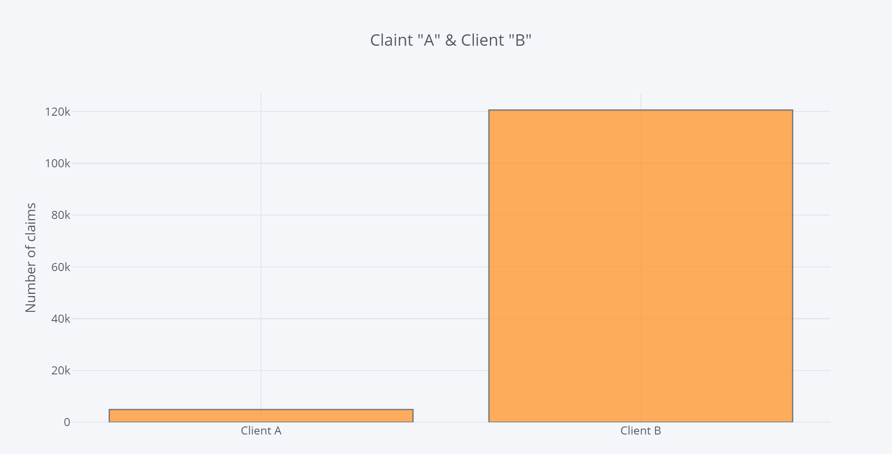
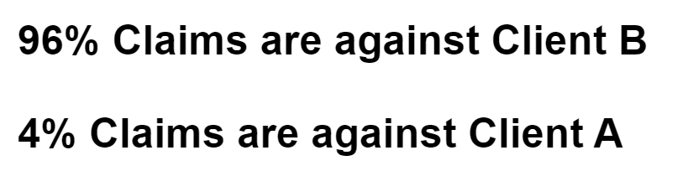

EDA on Client Column
z

Slide 8
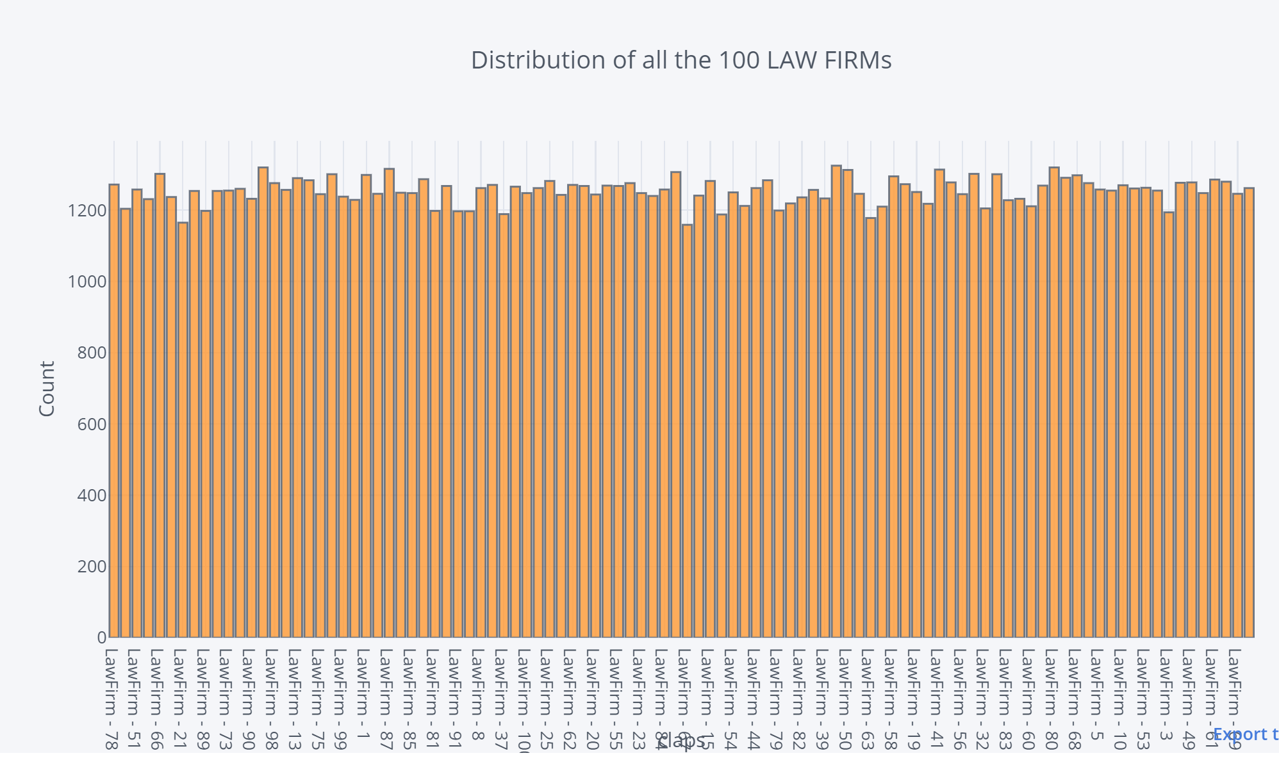
EDA on Law Firms Almost all the 100 Law Firms are in range 1100 - 1300

Slide 9
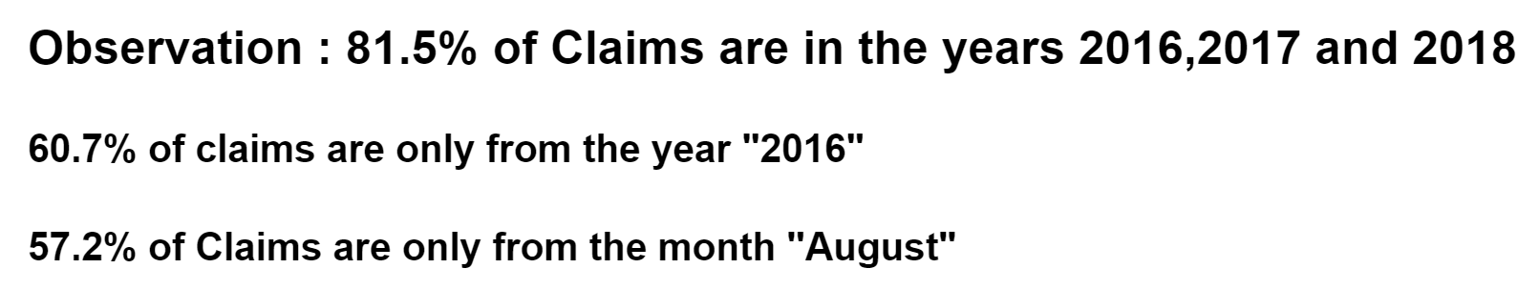
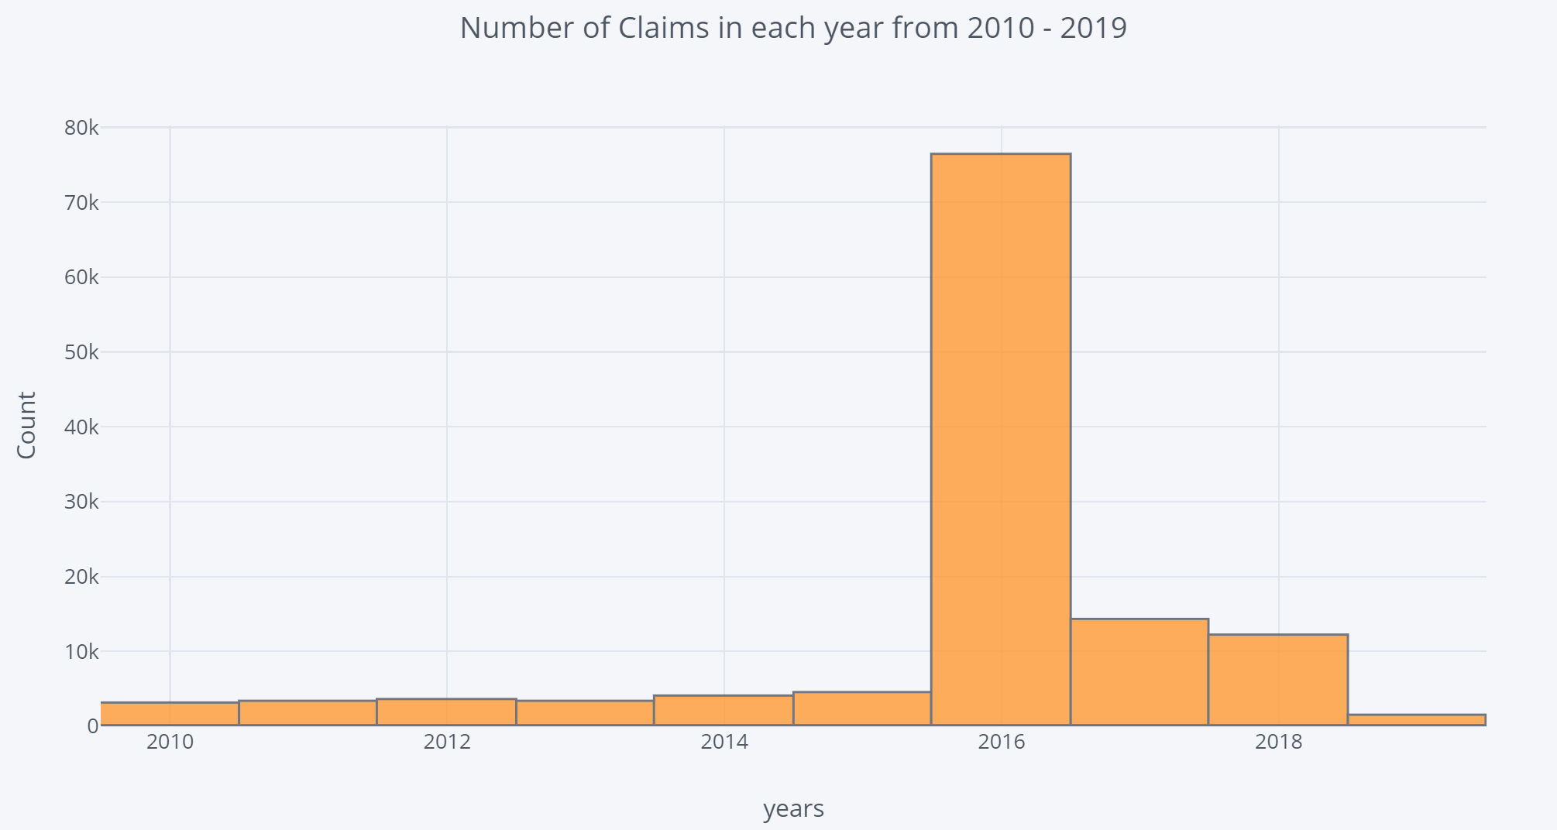
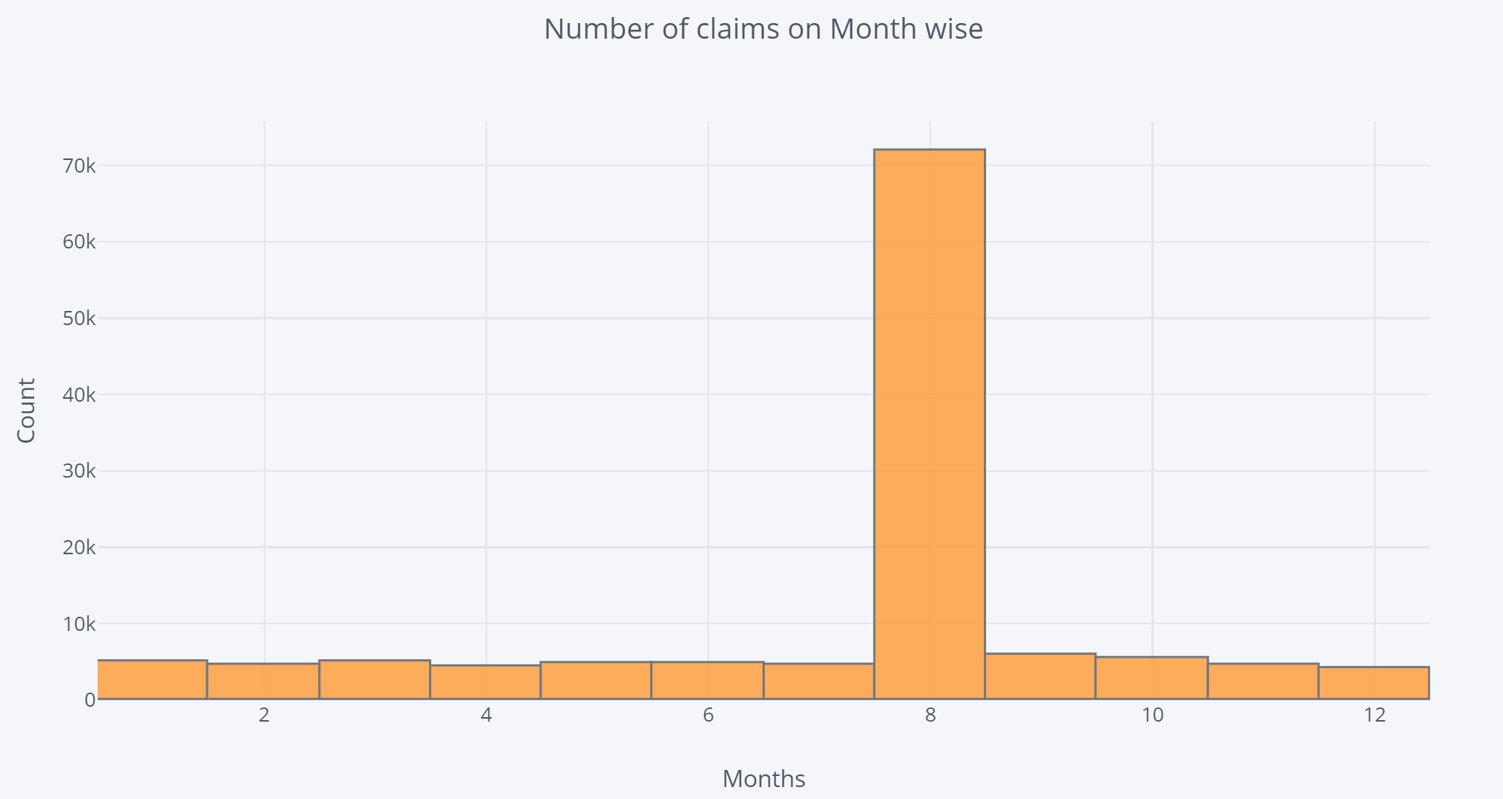
EDA on Date Column (Yearly and Month)

Slide 10
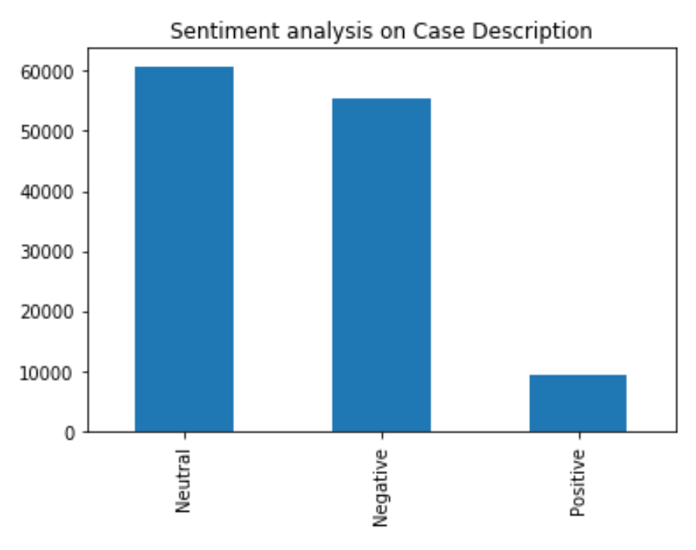
Sentiment Analysis on the Case Description

Slide 11
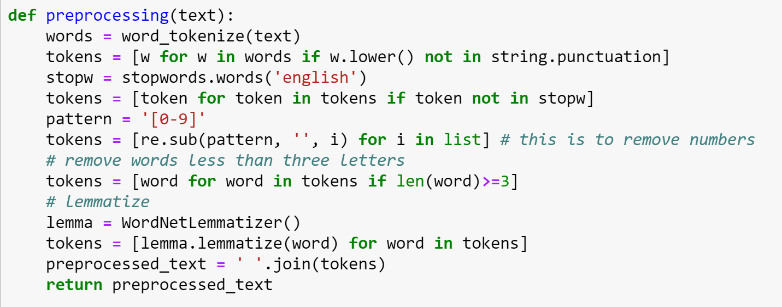
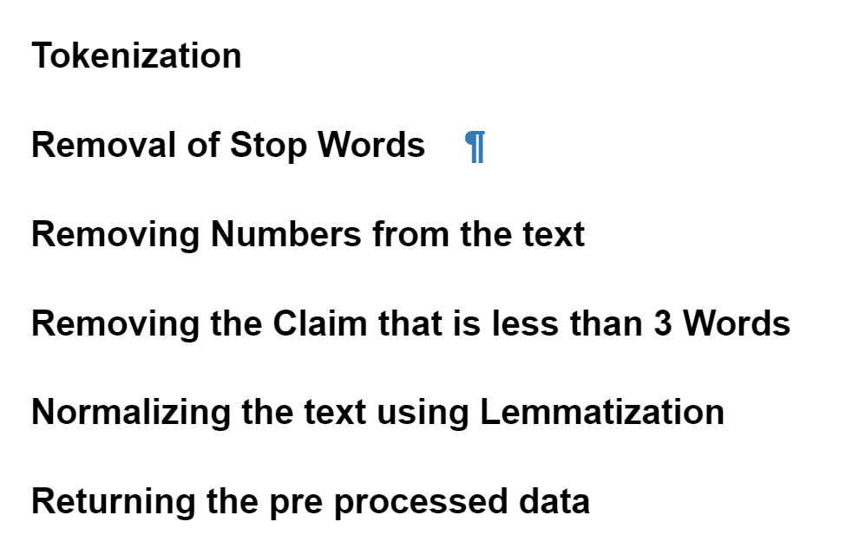
NLP techniques on Case Description Text Pre-processing
z

Slide 12
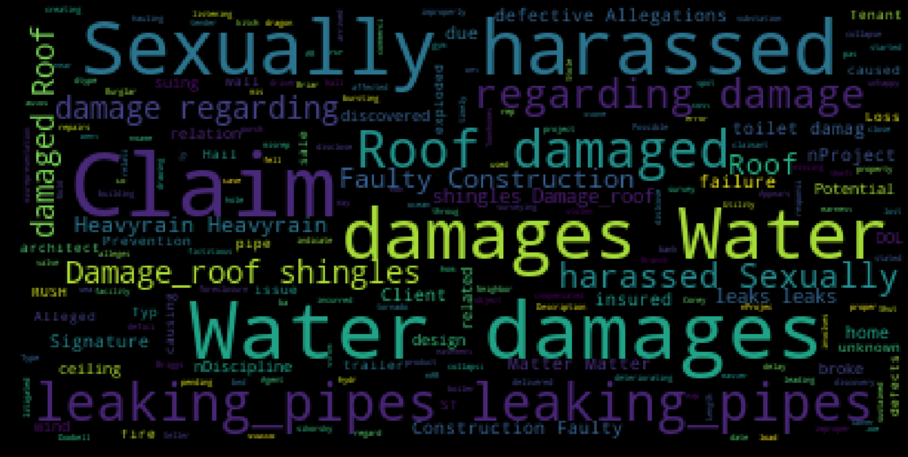
WordCloud on the Case Description

Slide 13
Clustering, Topic Modelling and N-Grams on “CASE DESCRIPTION”

Slide 14
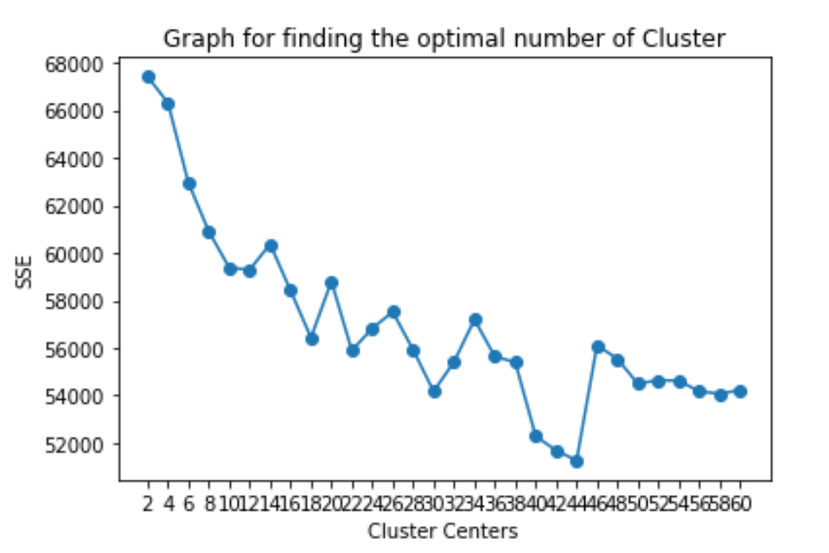
Graph for finding the Optimal number of Clusters
Optimal number of Clusters = 44

Slide 15
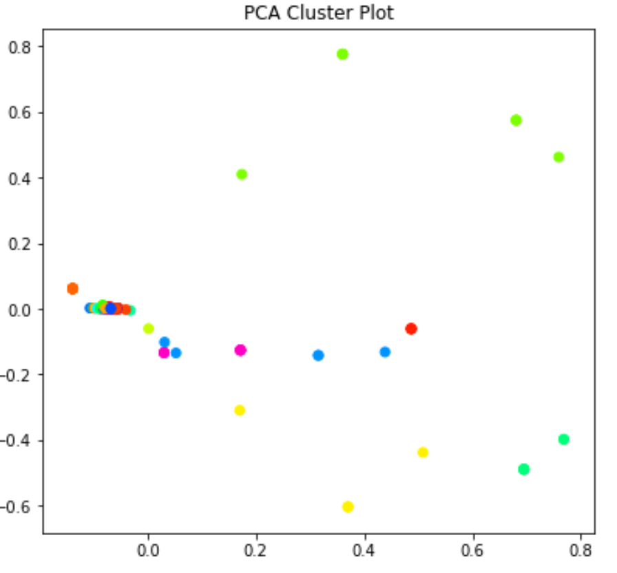
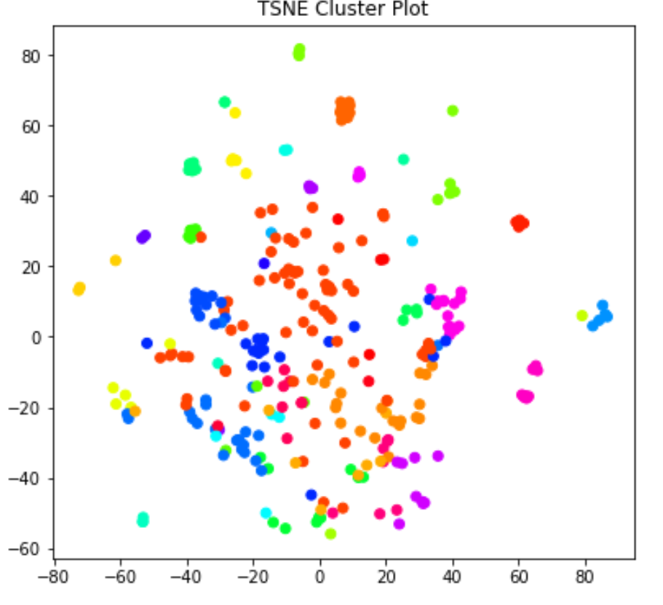
PCA & TSNE for visualizing the 44 Clusters

Slide 16
Cluster 0 tort,company,intentional,business,relations,tortuous,interference,claims,services,miscellaneous Cluster 1 error,escape,zurich,dscm,discrimination,hiring,promotion,retaliation,discharge,age Cluster 2 misrepresentation,insd,negligent,religion,error,benefits,denial,employee,fraud,flsa Cluster 3 escalate,erupted,errors,error,escaped,zurich,policy,violation,statutory,public Cluster 4 work,injured,lower,unspecified,trauma,multiple,cumulative,injuries,injury,ee Cluster 5 water,employee,left,tripped,walking,wet,ee,slipped,fell,floor
First 5 Clusters from 44 Clusters using Mini Batch K-Means

Slide 17
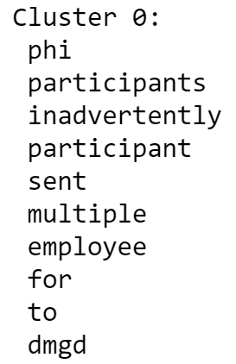
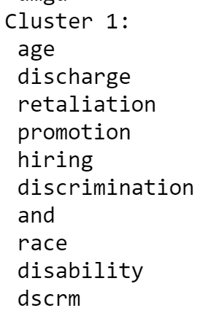
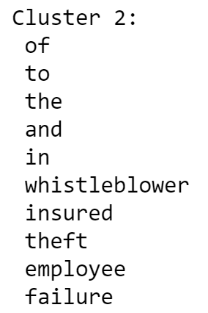
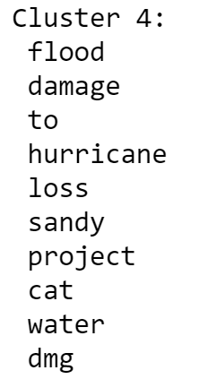
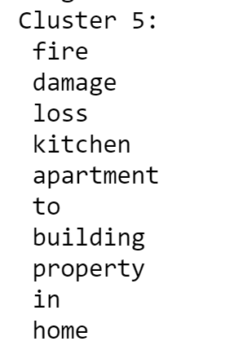
First 5 Clusters using K-Means Note: You can see better information from the clusters in the Ipynb

Slide 18
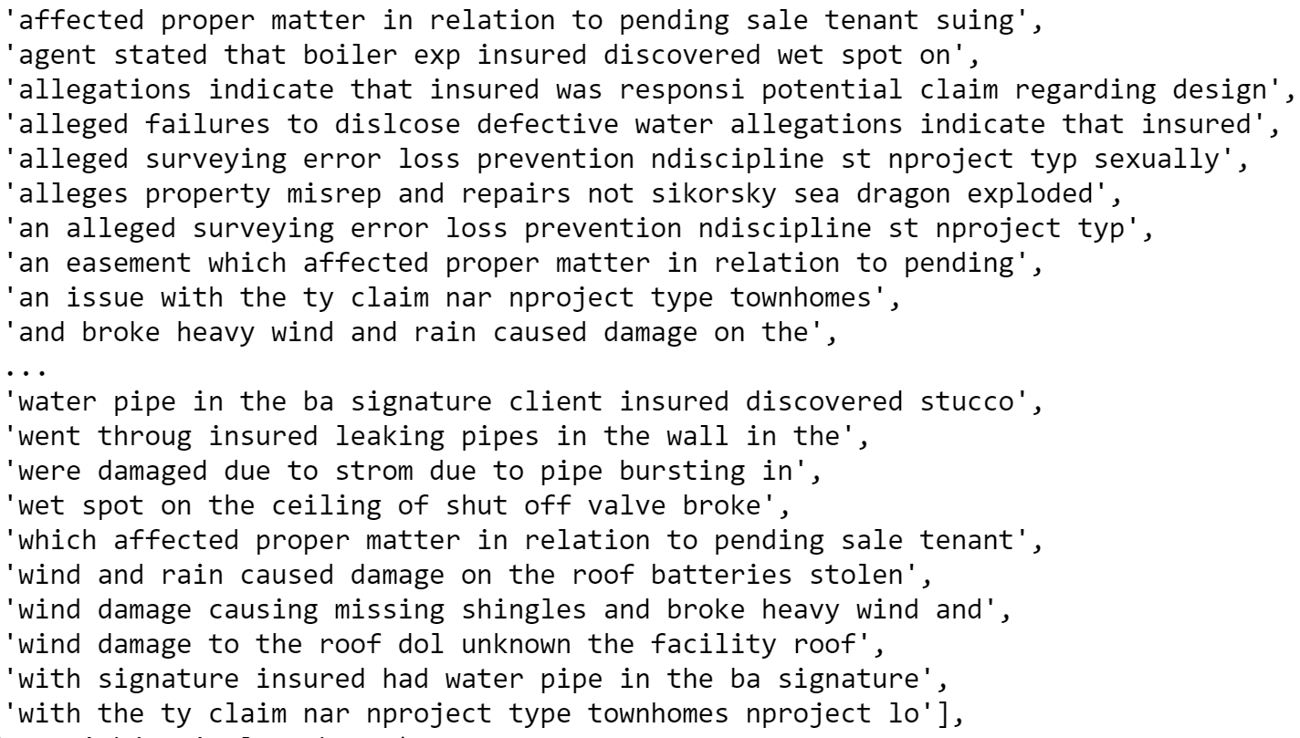
Count Vectorized for finding the meaning out of the data using N-Grams

Slide 19
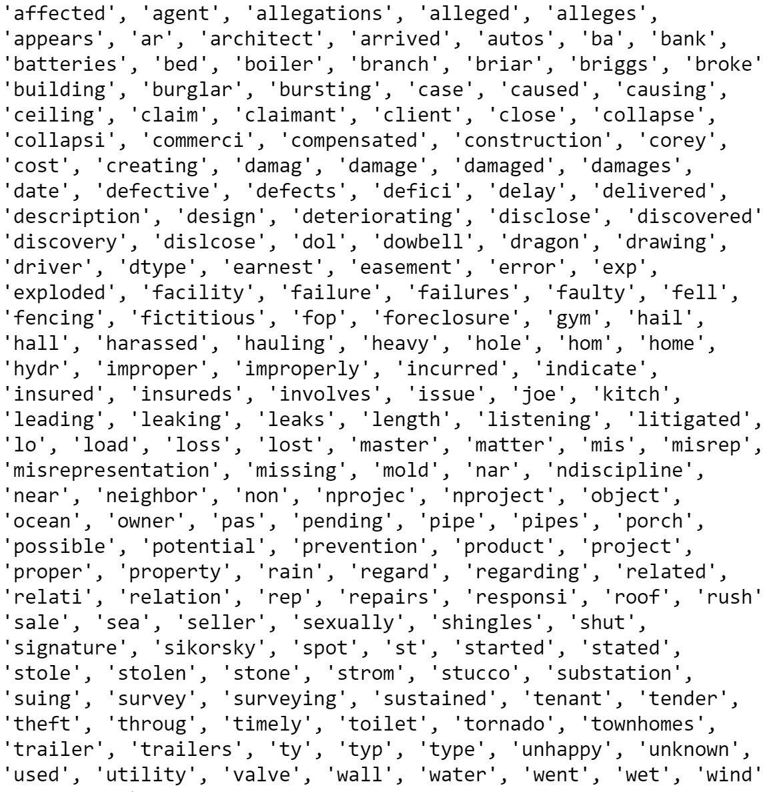
Feature Names from LDA
z

Slide 20
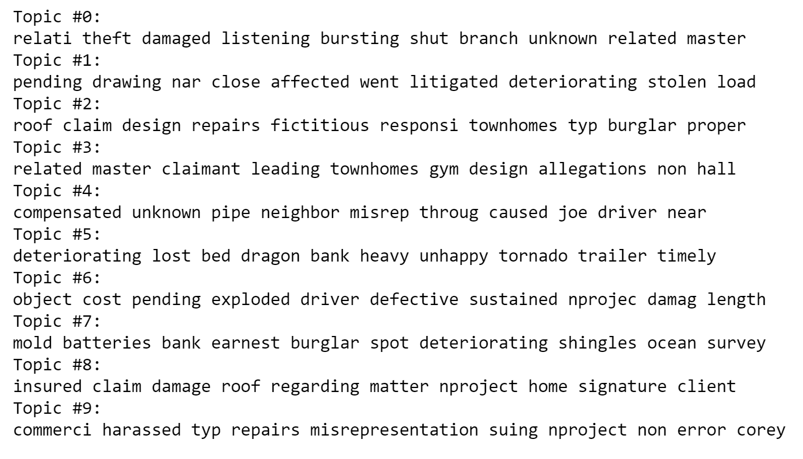
LDA & TF-IDF for finding the most discussed top 10 topics

Slide 21
Depth Analysis only on the August Month Because Only in August 57% claims had registered

Slide 22
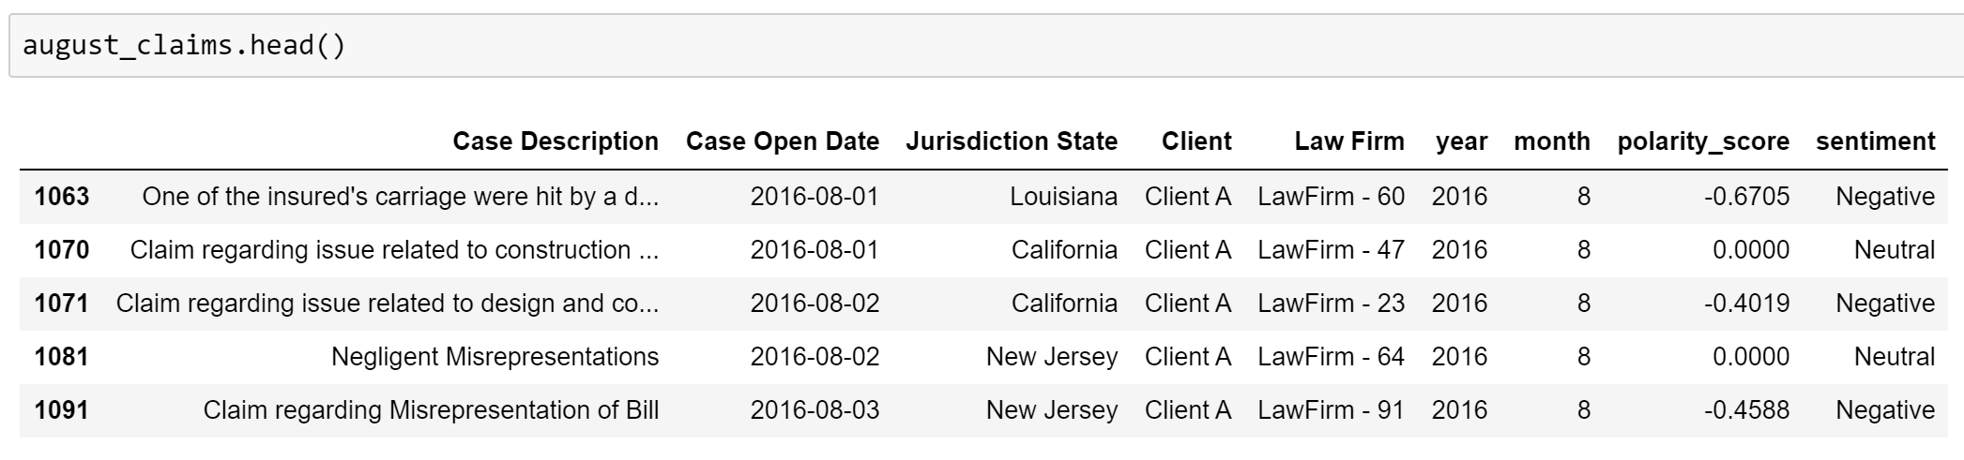
Data filtered only for the month of ‘AUGUST’

Slide 23
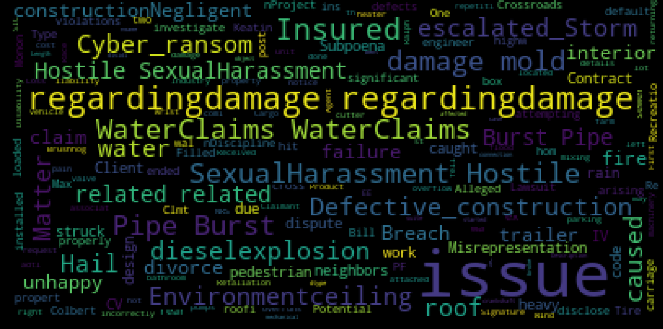
WordCloud for the claims that are registered in the month of ‘AUGUST’

Slide 24
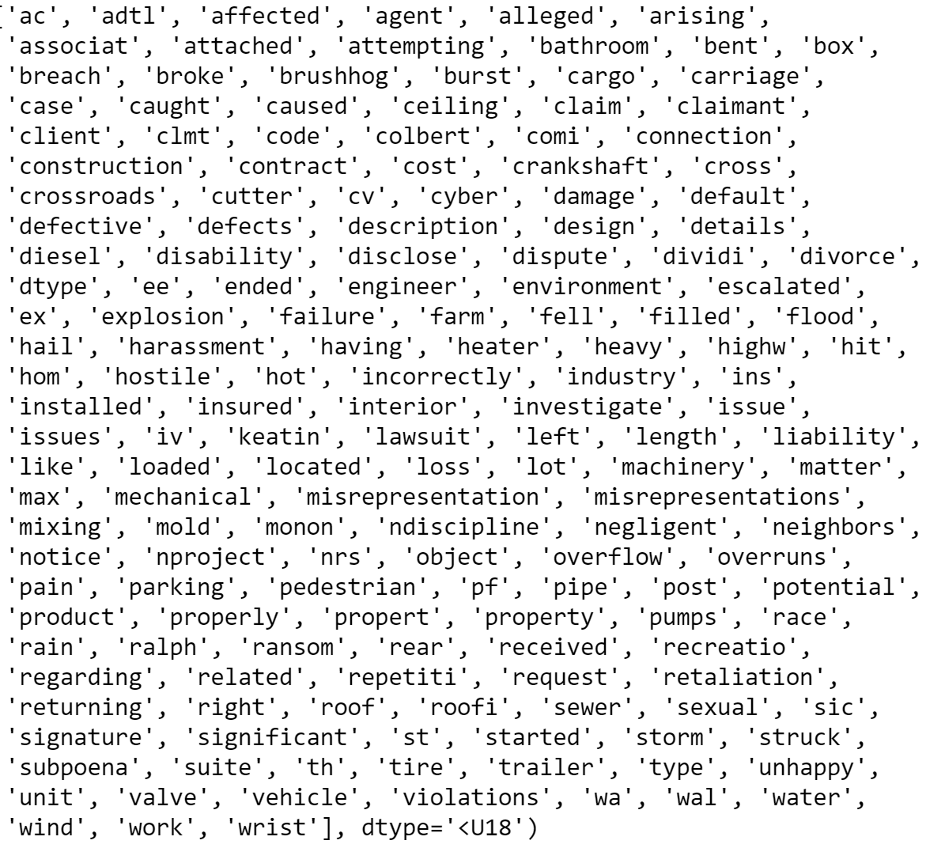
LDA Feature Names
z

Slide 25
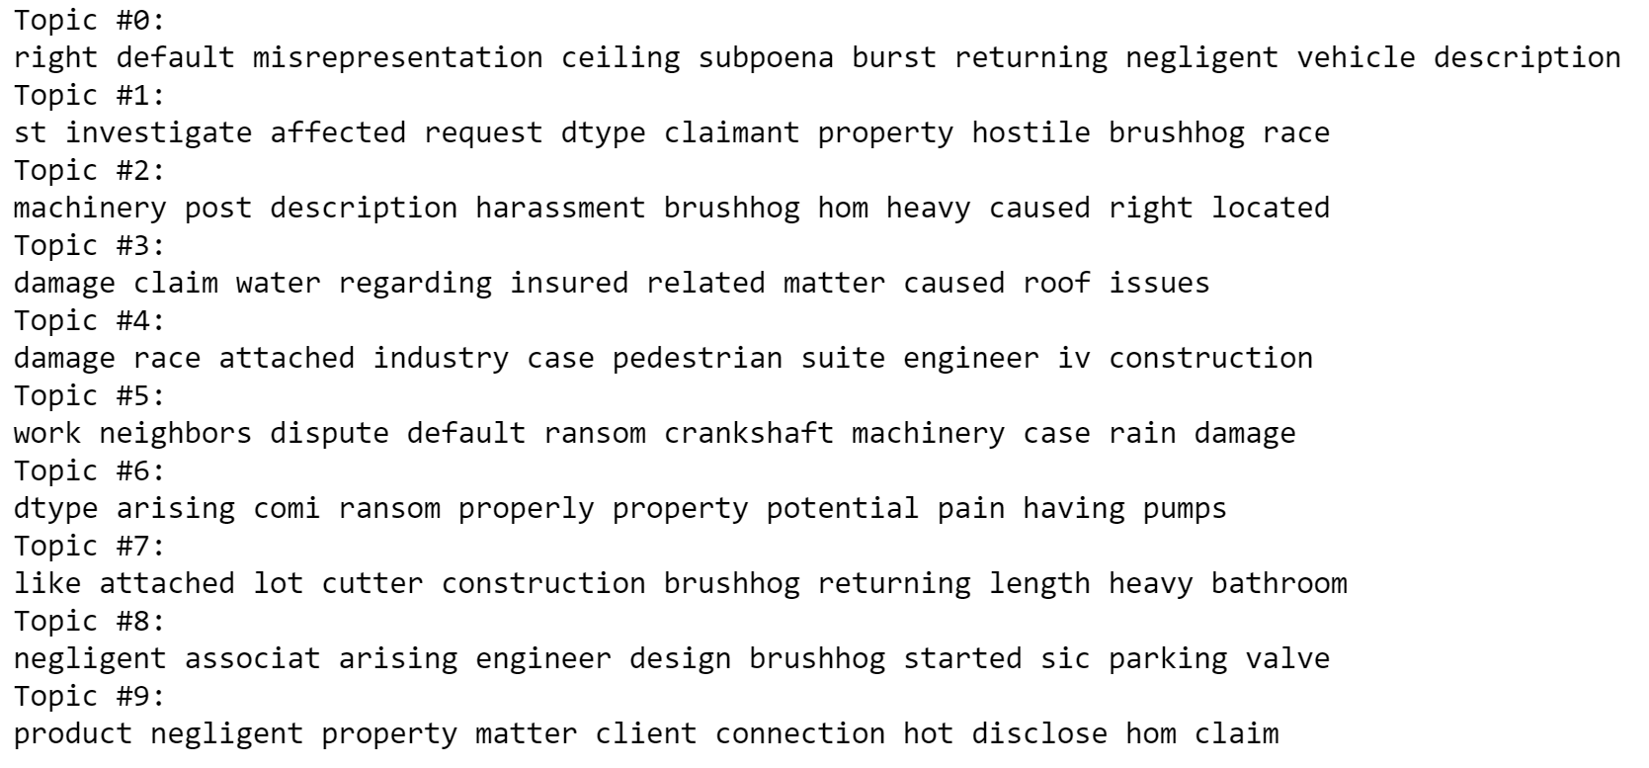
Top 10 Topics key words from LDA

Slide 26
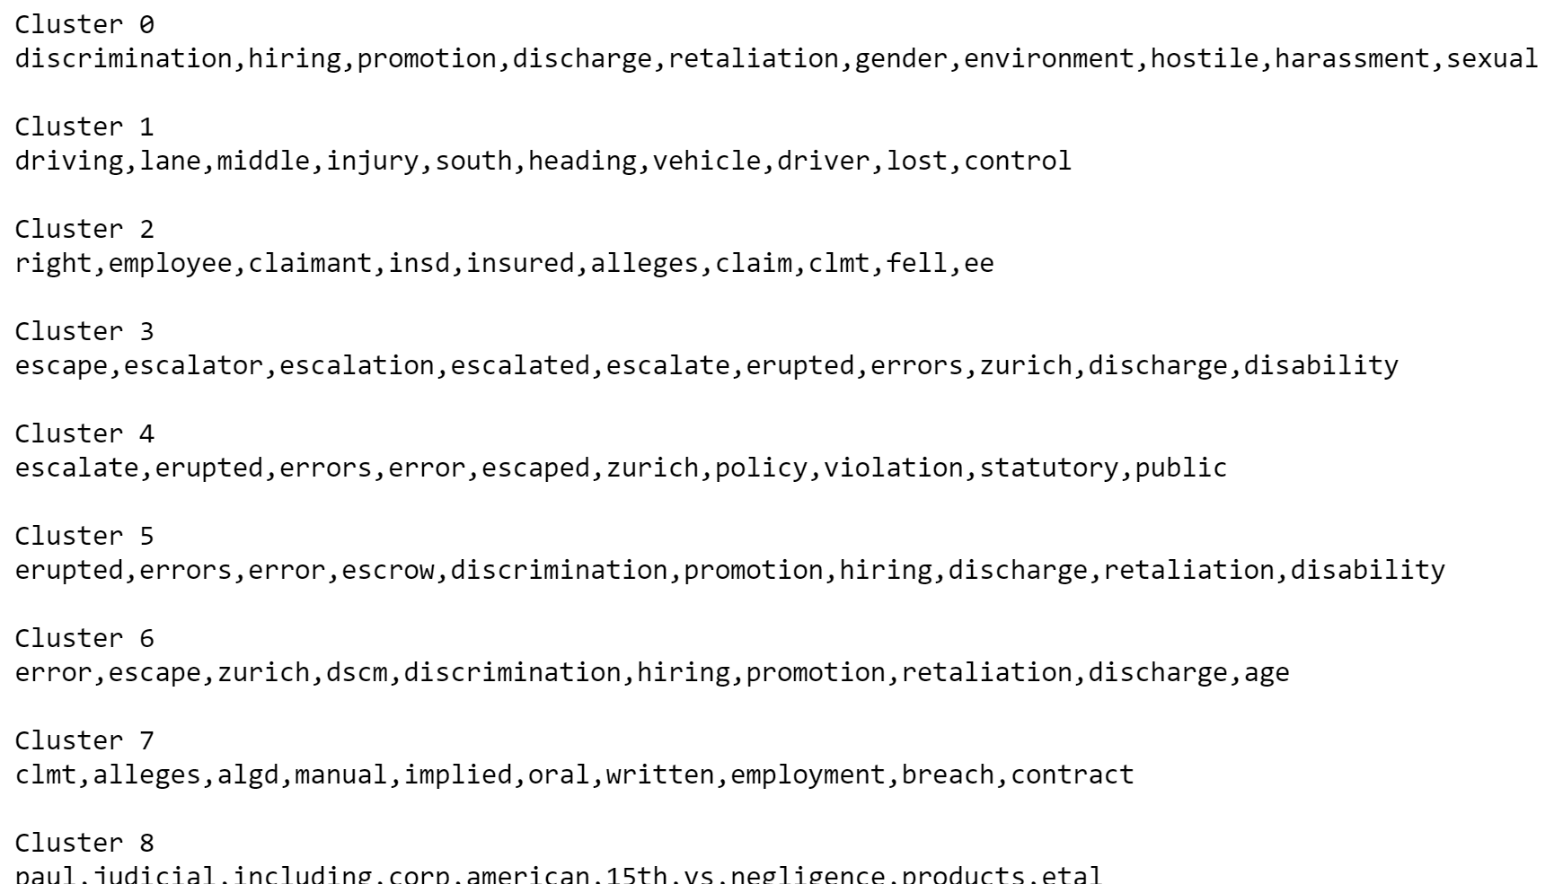
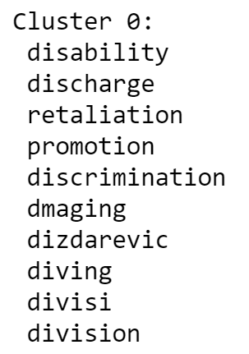
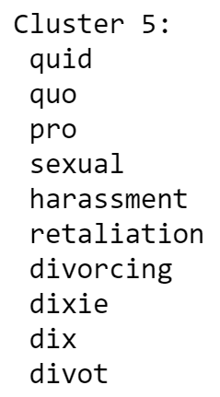
Clustering using K-Means & Mini Batch K-means

Slide 27
Thank you very much for your time

